Slide 1
Incident Response (IR) Disaster Recovery (DR) Business Continuity (BC) Gerhard Steinke

Slide 2

The DRP’s goal: get critical systems back in operation as quickly as possible.
Notes:
2

Slide 3
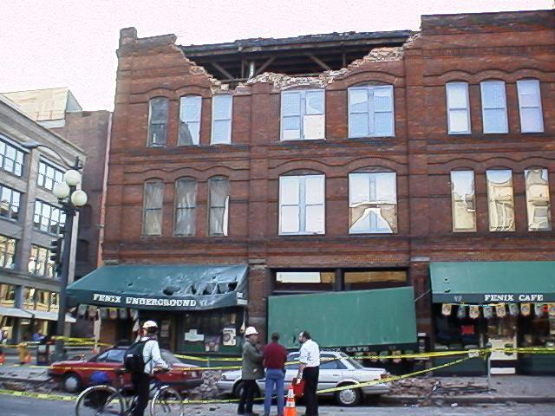
Business Continuity (BC): ensure continuity of service and support for its customers … before, during and after an event.
Notes:
3

Slide 4

…reestablish critical business operations
Notes:
4

Slide 5
Continuity Strategies
Incident response plans (IRPs)
IRP focuses on immediate response; if attack escalates or is disastrous, process changes to disaster recovery and BCP
Disaster recovery plans (DRPs)
DRP typically focuses on restoring systems after disasters occur;
Business continuity plans (BCPs)
BCP …requiring more than simple restoration of information and information resources

Slide 6
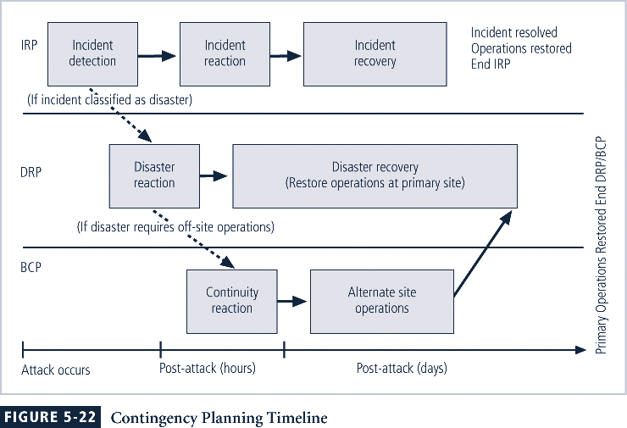

Slide 7
Continuity Strategy Planning
Champion: high-level manager to support, promote, and endorse findings of project
Project manager: leads project
Team members: should be managers, or their representatives, from various communities of interest: business, IT, and information security

Slide 8
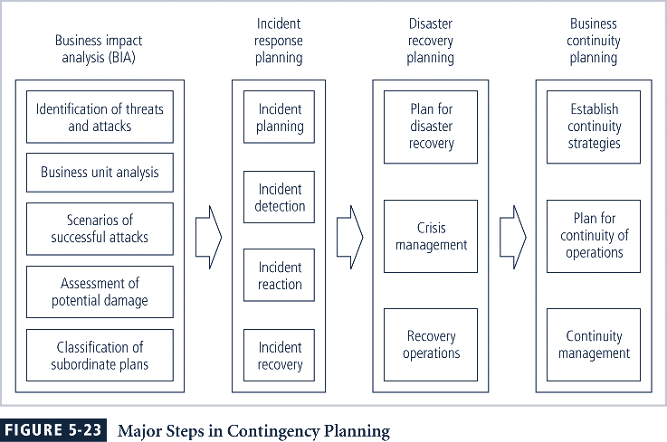

Slide 9
Incident Response Planning
covers identification of, classification of, and response to an incident
Attacks classified as incidents if they:
Are directed against information assets
Could threaten confidentiality, integrity, or availability of information resources
Incident response (IR) is more reactive than proactive

Slide 10
Incident Planning
Predefined responses enable organization to react quickly and effectively to detected incident if:
Organization has IR team
Organization can detect incident
IR team consists of individuals needed to handle systems as incident takes place
Planners should develop guidelines for reacting to and recovering from incident

Slide 11
Incident Detection
Most common occurrence is complaint about technology, often delivered to help desk
Careful training needed to quickly identify and classify an incident
Once attack is properly identified, organization can respond

Slide 12
Incident Response
Planning responses for security scenarios in advance
Employees learn to recognize any attempted security violation
Know what type of information to report (who, what, when, where)
Timing is important – you need to be prepared to act quickly and accurately

Slide 13

Incident Response Process
Sequence of common phases in responding to (potential) security incidents:
Preparation
Identification
Containment
Eradication
Recovery
Follow Up

Slide 14
1. Preparation
Develop notification, investigation, and response procedures that will integrate with organization’s existing policies and standards
Ensure that effective backup procedures are in place
Clearly define roles and responsibilities
Have contact info

Slide 15
2. Identification
Someone notices something unusual…
Intrusion detection systems, firewalls, system logs, network or system “behavior” that diverts from the norm
Central reporting point – Security hot line, Help Desk,…
Identify and determine whether to activate the IR plan

Slide 16
3. Containment
Determine if/when a system will be removed from the network due to the risk that it represents—may require high level approval
Often organizations don’t have time to do a lot of forensics activities to dissect a compromise—make a backup of the system in its compromised state to examine later or to use in getting outside advice about what occurred
Preserve logs, take notes, use the information you can get from the system involved, check if other systems are affected

Slide 17
4. Eradication
Ensure that network or systems are “clean”
Obtain assistance from your ISP or network provider to successfully stop the attacks
Most viruses can successfully be removed, but determining whether all traces of a root-level compromise can be found and fixed can be time-consuming
May require completely wiping/formatting a system.

Slide 18
5. Recovery
If it is not possible to remove all traces of infection or problems, restore/reload an affected system from the “last good” backup
Specify the criteria you will employ in making a decision as to when to restore network services to an affected system
Continue to monitor the system for related problems.

Slide 19
6. Follow Up
Document incident
Record the “lessons learned”
Propose changes to be made in policies or procedures to prevent further problems or faster response next time
Historical information on incidents supports future budgetary and staffing needs.

Slide 20
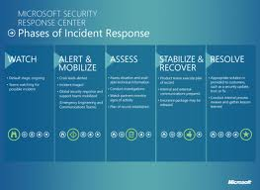
Testing Incident Response Plan
If no incidents tabletop test
Incident response awareness program
Test restore capabilities
Improve plan
Update contact information

Slide 21

Disaster Recovery
respond to a serious interruption in services and restore an organization’s critical business functions as rapidly as possible
Activities and programs designed to return the organization to an acceptable condition

Slide 22

Why Plan For Disaster?
Officers, executives and managers of a company are morally, ethically and legally bound to make decisions and plans that will insure the business continues to operate and serve customers and service recipients.
Notes:
22

Slide 23
Disaster Recovery Planning
Disaster recovery planning (DRP) is planning the preparation for and recovery from a disaster
The contingency planning team must decide which actions constitute disasters and which constitute incidents
When situations classified as disasters, plans change as to how to respond; take action to secure most valuable assets to preserve value for the longer term
DRP strives to reestablish operations at the primary site
Hot site, warm site, cold site

Slide 24
Planning DR/BC
Identifying mission- or business-critical functions
Identifying resources that support critical functions
Anticipating potential contingencies or disasters
Selecting contingency planning strategies
Implementing contingency strategies
Testing and revising strategy

Slide 25
Steps for DR/BC Planning
Executive sponsorship
Create a committee from all areas of the organization
Perform risk assessment / business impact analysis
Determine critical systems
Recovery planning
Document the plan
Priorities
Procedures to restore operations
Contact information
Develop testing plan
Test
Review and update

Slide 26
DR/BC Issues
Who has copies of the plan?
Back-up practice and policy
Test the recovery location, backup
System, network and application contingency
All new applications have to integrate BC in their architecture

Slide 27

Physical Issues
Physical Access
access and damage at a building level
access to sensitive areas within the building
protection of individual/organizational assets.

Slide 28

Remember the People…
Personnel issues
Transportation problems
Site location, accessibility
Public relations challenges
Monitor morale
Offer support and counseling
Protect dedicated staff from burnout
Meals, coffee
Enforce upper limits on hours/ days worked
Disaster effects may debilitate people long after the actual event.
Notes:
28

Slide 29
Crisis Management
Actions taken during and after a disaster that focus on people involved and address viability of business
Crisis management team is responsible for managing event from an enterprise perspective and covers:
Supporting personnel and families during crisis
Determining impact on normal business operations and, if necessary, making disaster declaration
Keeping the public informed
Communicating with major customers, suppliers, partners, regulatory agencies, industry organizations, the media, and other interested parties

Slide 30
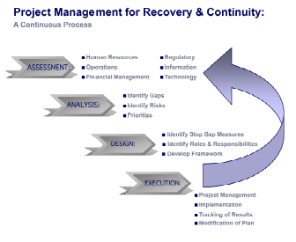
KPMG Business Recovery Model
Notes:
30

Slide 31

ARE YOU PREPARED?
Notes:
31

